Slide 1
Outdoor Hikes in and around Monroe County
Student Involvement and Leadership Center

Slide 2
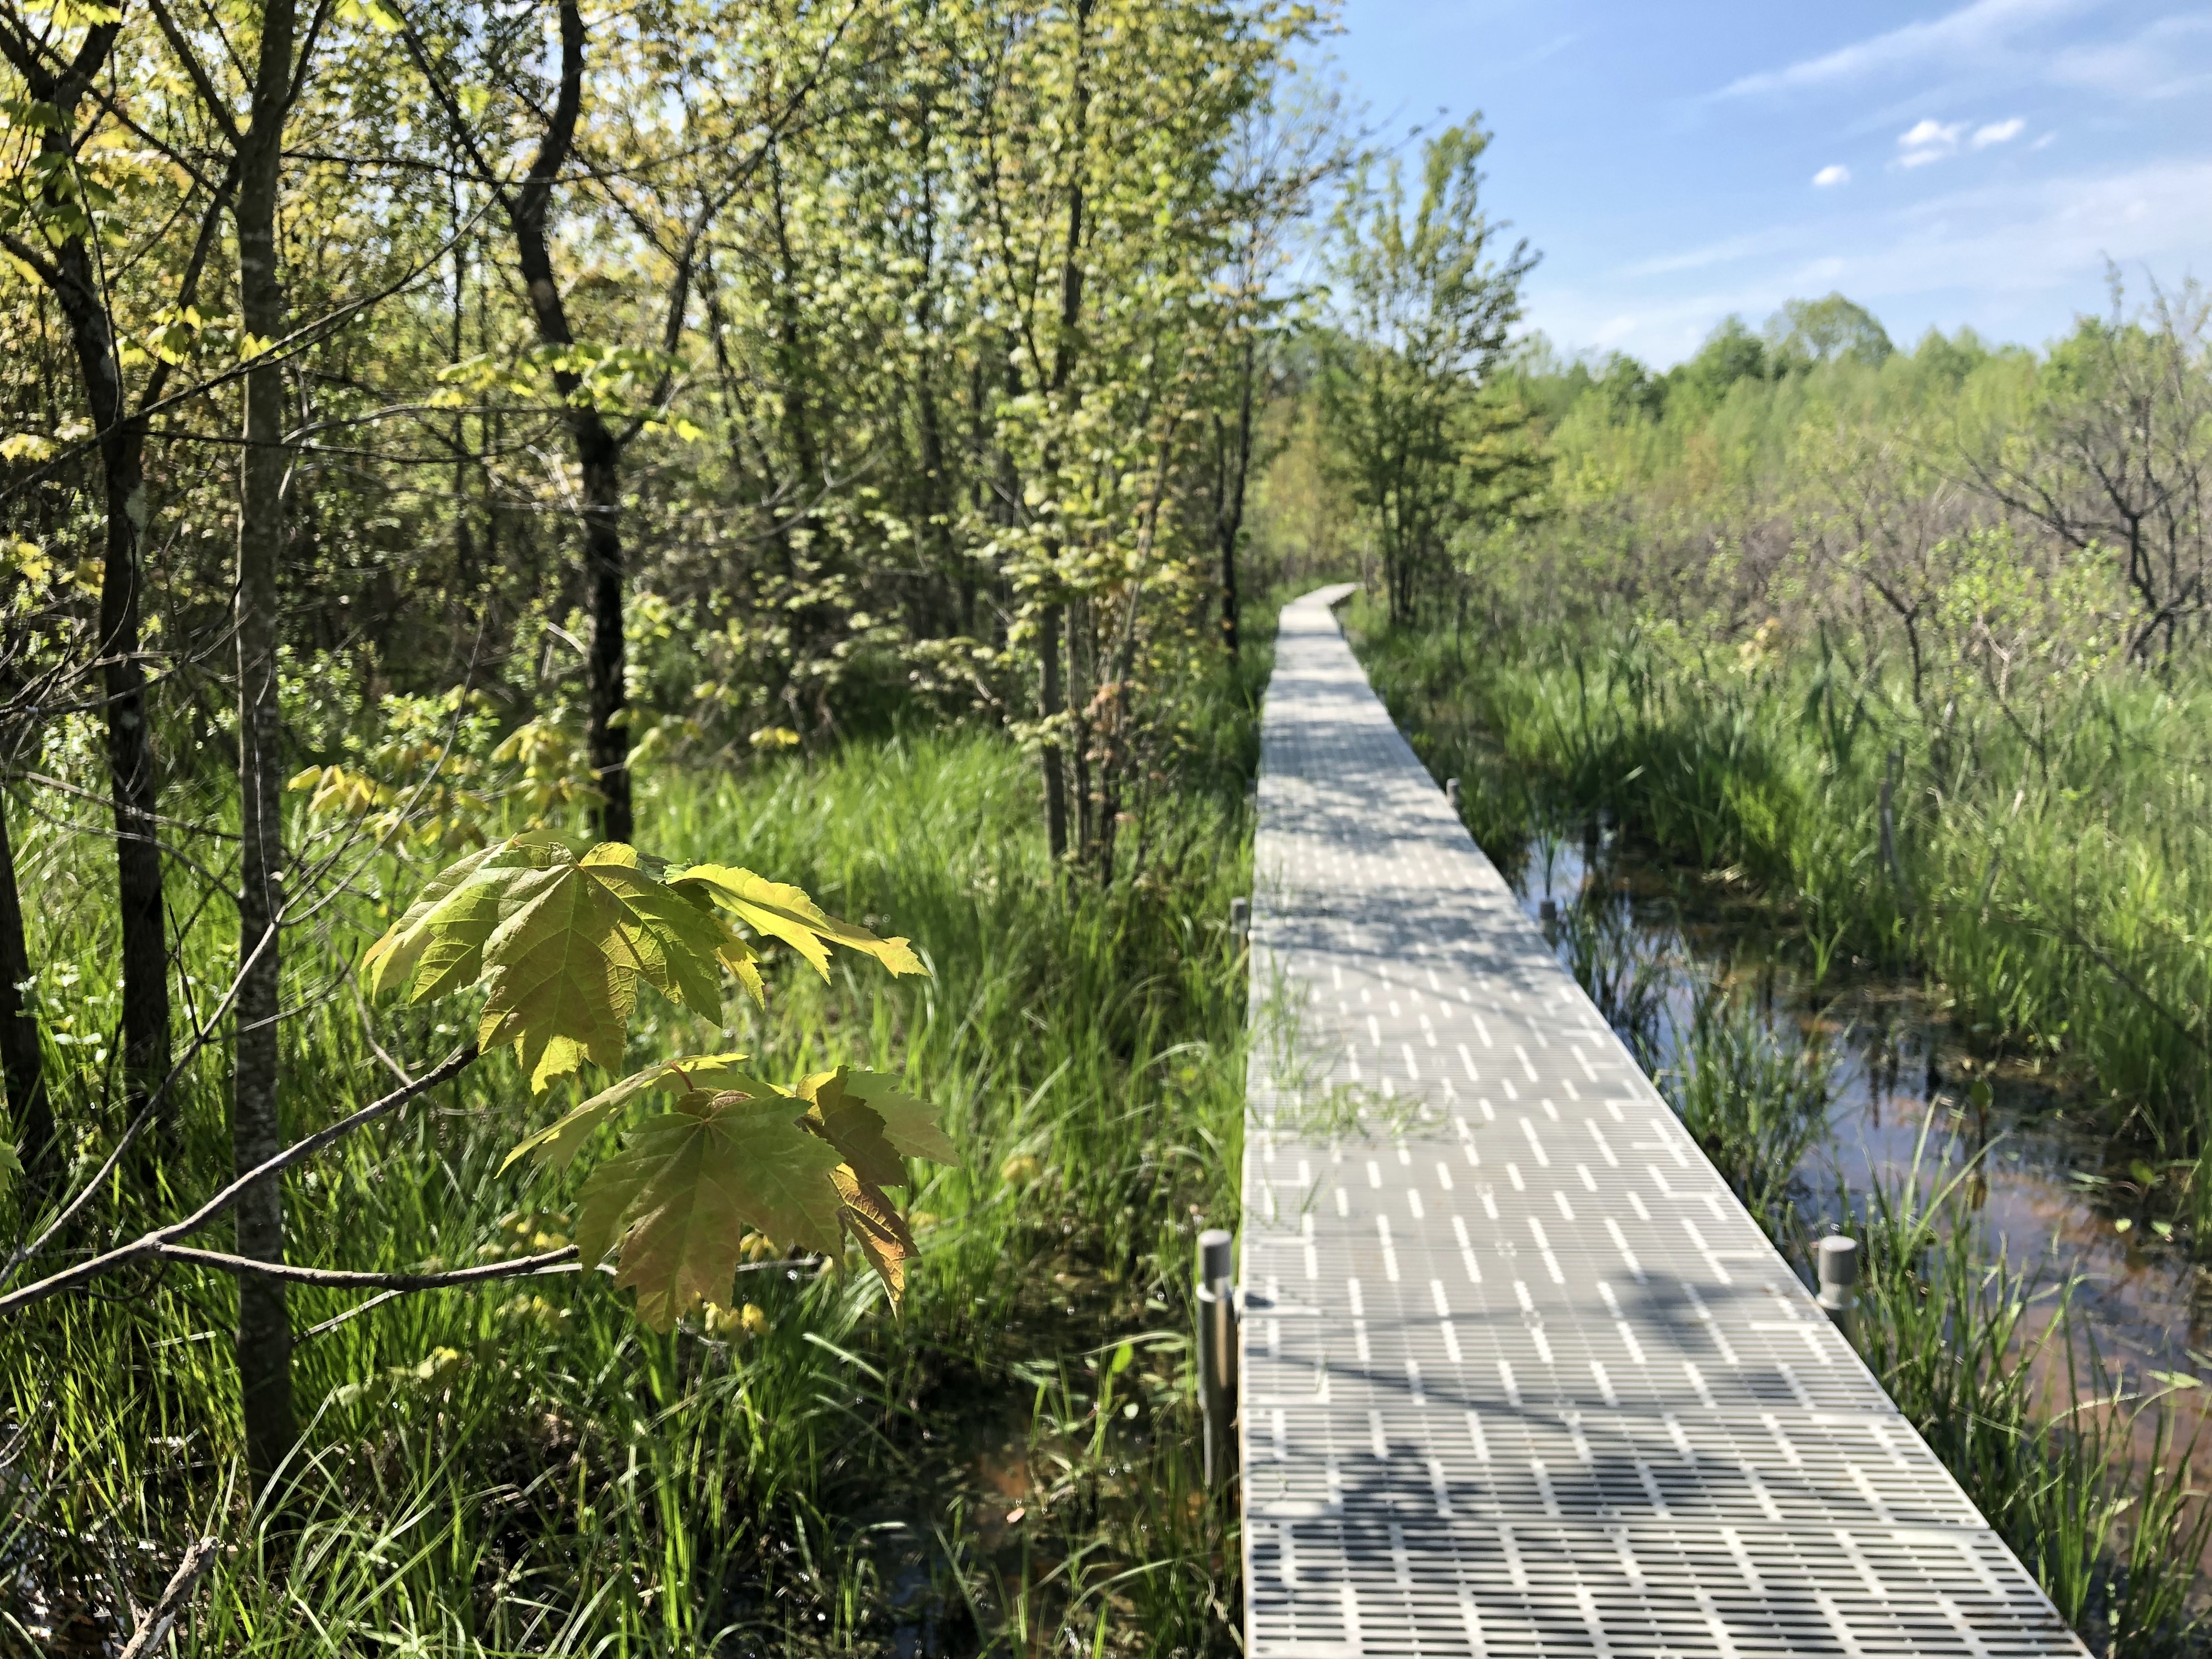
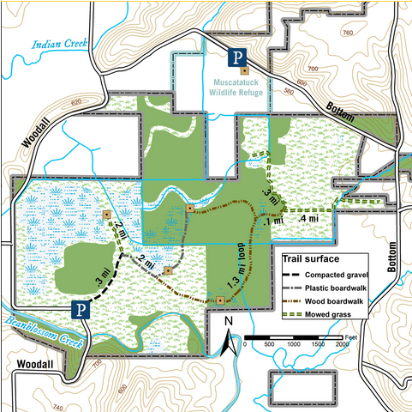
Beanblossom Bottoms Nature Preserve
Bloomington, IN

Slide 3
Beanblossom Bottoms Nature Preserve
About: This large wetland preserve features a diverse combination of bottomland hardwood forest, shrub wetlands, sedge meadow, and 80 species of bird - including bald eagles that have actively nested there for the past several years.
Location: N. Woodall Road, Bloomington, IN 47404
Trail Info: 2.5 miles, flat trail featuring a gravel path and boardwalk surface
Parking: Gravel parking lot at trailhead
Visiting Hours: Dusk to Dawn, Seven Days a Week

Slide 4
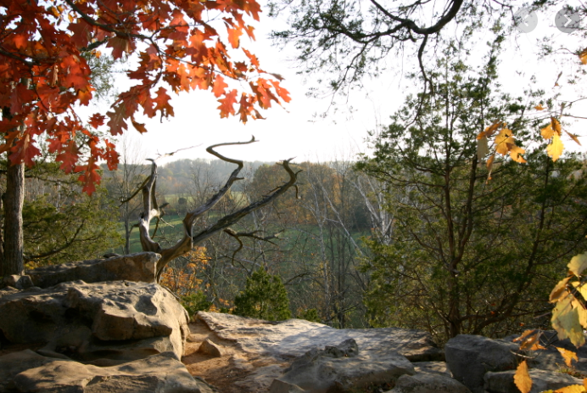
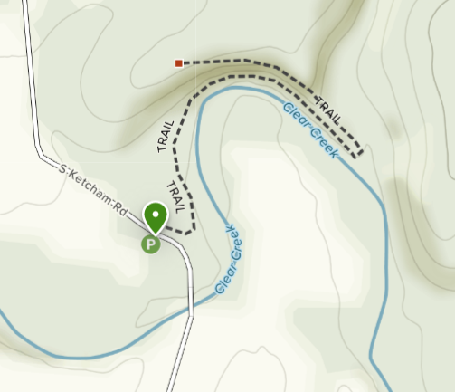
Cedar Bluff Nature Preserve
Bloomington, IN

Slide 5
Cedar Bluff Nature Preserve
About: Featuring an impressive 75-foot high limestone bluff with red cedars clinging to cliff sides, this challenging terrain with scenic views have made this preserve a Hoosier favorite.
Location: 8484 S. Ketcham Road, Bloomington, IN 47403
Trail Info: 1.9 miles, mostly rugged and rocky
Parking: Gravel parking lot across the road from beginning of trailhead
Visiting Hours: Dusk to Dawn, Seven Days a Week

Slide 6
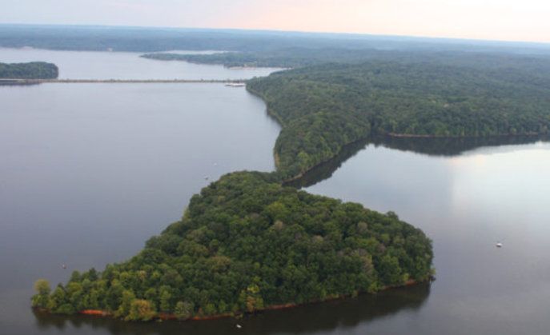
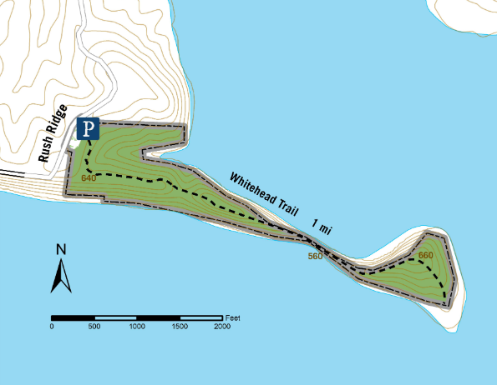
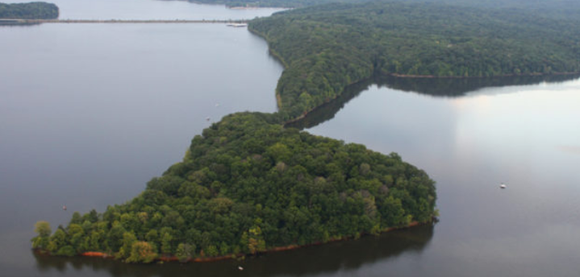
Amy Weingartner Branigin Peninsula Preserve
Bloomington, IN

Slide 7
Amy Weingartner Branigin Peninsula Preserve
About: This special peninsula preserve is located in the middle of Monroe Lake, and features a long, forested ridge that extends out into the lake. This area is inhabited by red-shouldered hawks, broad-winged hawks, and eastern box turtles.
Location: 7466 E. Rush Ridge Road, Bloomington, IN 47401
Trail Info: 2.2 miles, moderately rugged and rocky
Parking: Parking lot at the trailhead
Visiting Hours: Dusk to Dawn, Seven Days a Week

Slide 8
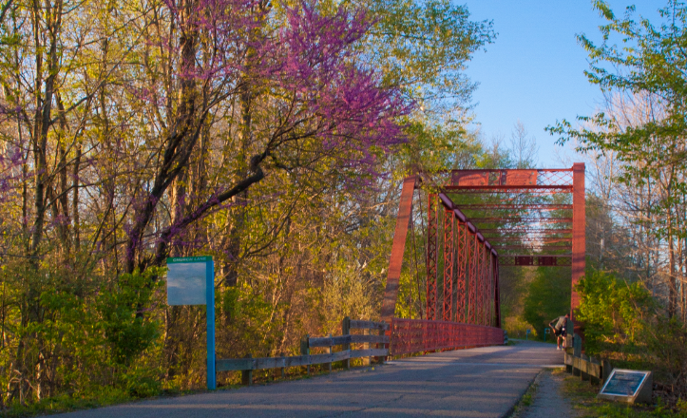
Clear Creek Trail
Bloomington, IN

Slide 9
Clear Creek Trail
About: Stretching from Tapp Road to Church Lane, the Clear Creek Trail offers visitors a paved path for biking, walking, jogging, rollerblading or stroller walking through landscapes that vary from woods to farm fields.
Location: W. Tapp Road, Bloomington, IN 47408
Trail Info: 2.5 miles, flat paved path
Parking: Parking lot at the trailhead
Visiting Hours: Dusk to Dawn, Seven Days a Week

Slide 10
Most Accessible Parks
BRYAN PARK - Paved running path, playground equipment, and outdoor exercise gym. Also includes basketball courts, tennis courts, volleyball courts, and horseshoe pits.
FLATWOODS PARK - Paved Interpretive Trail with butterfly garden and wildflower field. Flatwoods Park is a peaceful, 198-acre park located near Ellettsville. The park offers several outdoor amenities including playgrounds, basketball courts, a windmill, and a giant sundial.
KARST FARM PARK - A120-acre park with several playgrounds, basketball courts, shuffle board courts, horseshoe pits, volleyball courts, a 9-hole disc golf course, ponds, and natural areas.
LEONARD SPRINGS NATURE PARK - Highlights include Leonard and Shirley Springs, caves, steep forested slopes, and a wetlands area. This nature park is designed to provide observation and educational opportunities.
SWITCHYARD PARK - Paved running path (B-line trail), playground equipment, basketball, pickleball, and bocce ball courts.

Slide 11
Most Recommended State Parks & Forests
BROWN COUNTY STATE PARK - Those who enjoy exploring parks by hiking or mountain biking will find many miles of well-marked trails. Nicknamed the “Little Smokies” because of the area’s resemblance to the Great Smoky Mountains, Brown County State Park encompasses nearly 16,000 acres of rugged hills, ridges, and ravines.
MCCORMICKS CREEK STAET PARK - Explore the spectacular limestone canyon, flowing creek, a fire tower, and scenic waterfalls that highlight Indiana’s first state park. Hike trails featuring diverse forest trees, and native wildflowers, including a trail through Wolf Cave Nature Preserve and an accessible trail at the recently renovated nature center.
MORGAN-MONROE STATE FOREST - The forest land encompasses many steep ridges and valleys, and is forested with some of the state's finest hardwoods.
SPRING MILL STATE PARK - This park offers an illustration of the link between the natural and cultural worlds. The water flowing from several cave springs led to the founding of an industrial village in the early 1800s. Pioneer entrepreneurs took advantage of a constant water source that never froze, using it to power several gristmills, a wool mill, a saw mill, and a distillery.
YELLOWOOD STATE FOREST - This forest’s 23,000 acres offer many recreation opportunities for people of all ages and skill levels. With three pristine lakes, hiking, horse trails, abundant wildlife, and campsites, Yellowwood will keep you busy.

